Slide 1
Smart Greenhouse
Customer Solution Center

Slide 2
Introduction
It is no longer sustainable to chop down tress to grow crops on the land. Greenhouse farming is one of the ways to grow crops in a sustainable manner. Greenhouse uses less water, no pesticides are required and has very high yield.
In this demo, we demonstrate how a greenhouse is transformed using Dell Technologies.

Slide 3
Smart infrastructure enables efficient enterprise IoT
Edge/Field
Fog
Cloud
Edge Gateway
Embedded PC
Security, Manageability, Analytics
Notes:
With the 50B new connected devices in the IoT it is not possible or efficient to send all of that data directly to the cloud. In fact Gartner predicts that only 2% of IoT data will ever make it to the data center/cloud for processing or storage <confirm stat>. That is because so much of the IoT machine data is what we call ‘perishable’ or only valuable for a couple of seconds when action can be taken on it. So much of the data is also only valuable when it is integrated with other data sources to identify events or insights. Take a building for example, the data from a connected lightbulb saying “I’m on, I’m on, I’m on” is not valuable unless it is correlated with the occupancy sensors, the security cameras, and thermostat where action can be taken.
That is why Dell recommends a distributed architecture for the IoT giving you flexibility to deploy processing and storage wherever it makes sense. This enables you to unlock the value of both existing and new data to increase efficiency, improve customer experience, or create new revenue streams and business models (Digital Transformation). Analytics, security, and manageability must also be distributed throughout the architecture.
Starting on the left is the Edge where the ‘Thing’ or Machine resides. This might be on a factory floor, in a 18 wheeler, a building controls room, or a remote oil well. Dell is not producing sensors for the IoT but we have developed Embedded PCs to gather data and control the ‘Things’.
Along some ‘Things’ will communicate directly to the Cloud, Gartner predicts that 90% of new IoT deployments by 2020 will include a gateway <confirm stat>. The gateway is the aggregation point of multiple ‘things’ where it normalizes the data from multiple OT (BACnet, Profinet, etc.) and IT (Bluetooth, ZigBee, WiFi) protocols, and processed to determine insights from the perishable data.
Depending on the use case, critical data identified by the gateway is then passed on to an on premise computing and storage solution located in what is called the Fog. The on premise solution will conduct big data analytics on the local data and complete local reporting.
Finally the data worth storing and completing deeper analysis on is then transferred to the cloud/data center. This is also where existing IT system data is integrated with the OT data and machine learning takes place to refine the use case based analytical models. You will see that the arrows throughout the architecture are 2-way because ideally these analytical models which are refined through machine learning are being pushed back out to the Edge and Fog to continuously improve the efficiency of your IoT deployment so it can handle the immense data volumes produced by the 50B new ‘Things’.

Slide 4

Industry’s broadest IoT infrastructure portfolio
EDGE/FIELD
CORE/FOG
CLOUD
Embedded | Gateways | On-Premise Appliances | Data Center & Cloud | Cloud & App Integration
Manageability & Security:
IoT & Data Analytics Services
IoT Solutions Partner Program
Global Support, Deployment, & Financing
Notes:
With the 50B new connected devices in the IoT it is not possible or efficient to send all of that data directly to the cloud. Because so much of the IoT machine data is what we call ‘perishable’ or only valuable for a couple of seconds when action can be taken on it. So much of the data is also only valuable when it is integrated with other data sources to identify events or insights. Take a building for example, the data from a connected lightbulb saying “I’m on, I’m on, I’m on” is not valuable unless it is correlated with the occupancy sensors, the security cameras, and thermostat where action can be taken.
That is why Dell recommends a distributed architecture for the IoT giving you flexibility to deploy processing and storage wherever it makes sense. This enables you to unlock the value of both existing and new data to increase efficiency, improve customer experience, or create new revenue streams and business models (Digital Transformation). Analytics, security, and manageability must also be distributed throughout the architecture.
Starting on the left is the Edge where the ‘Thing’ or Machine resides. This might be on a factory floor, in a 18 wheeler, a building controls room, or a remote oil well. Dell is not producing sensors for the IoT but we have developed Embedded PCs to gather data and control the ‘Things’.
Along some ‘Things’ will communicate directly to the Cloud. The gateway is the aggregation point of multiple ‘things’ where it normalizes the data from multiple OT (BACnet, Profinet, etc.) and IT (Bluetooth, ZigBee, WiFi) protocols, and processed to determine insights from the perishable data.
Depending on the use case, critical data identified by the gateway is then passed on to an on premise computing and storage solution located in what is called the Fog. The on premise solution will conduct big data analytics on the local data and complete local reporting.
Finally the data worth storing and completing deeper analysis on is then transferred to the cloud/data center. This is also where existing IT system data is integrated with the OT data and machine learning takes place to refine the use case based analytical models. You will see that the arrows throughout the architecture are 2-way because ideally these analytical models which are refined through machine learning are being pushed back out to the Edge and Fog to continuously improve the efficiency of your IoT deployment so it can handle the immense data volumes produced by the 50B new ‘Things’.

Slide 5



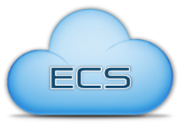



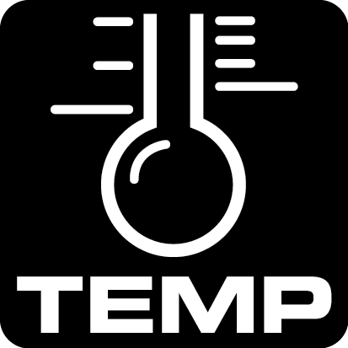



Smart Greenhouse
Sensors/Edge
Core/Fog
Cloud
Weather Web Service
PWS
Azure
AWS
Pivotal Cloud Foundry
MQTT
Edge Gateway
Isilon Data Lake
Security, Manageability, Analytics
Notes:
With the 50B new connected devices in the IoT it is not possible or efficient to send all of that data directly to the cloud. In fact Gartner predicts that only 2% of IoT data will ever make it to the data center/cloud for processing or storage <confirm stat>. That is because so much of the IoT machine data is what we call ‘perishable’ or only valuable for a couple of seconds when action can be taken on it. So much of the data is also only valuable when it is integrated with other data sources to identify events or insights. Take a building for example, the data from a connected lightbulb saying “I’m on, I’m on, I’m on” is not valuable unless it is correlated with the occupancy sensors, the security cameras, and thermostat where action can be taken.
That is why Dell recommends a distributed architecture for the IoT giving you flexibility to deploy processing and storage wherever it makes sense. This enables you to unlock the value of both existing and new data to increase efficiency, improve customer experience, or create new revenue streams and business models (Digital Transformation). Analytics, security, and manageability must also be distributed throughout the architecture.
Starting on the left is the Edge where the ‘Thing’ or Machine resides. This might be on a factory floor, in a 18 wheeler, a building controls room, or a remote oil well. Dell is not producing sensors for the IoT but we have developed Embedded PCs to gather data and control the ‘Things’.
Along some ‘Things’ will communicate directly to the Cloud, Gartner predicts that 90% of new IoT deployments by 2020 will include a gateway <confirm stat>. The gateway is the aggregation point of multiple ‘things’ where it normalizes the data from multiple OT (BACnet, Profinet, etc.) and IT (Bluetooth, ZigBee, WiFi) protocols, and processed to determine insights from the perishable data.
Depending on the use case, critical data identified by the gateway is then passed on to an on premise computing and storage solution located in what is called the Fog. The on premise solution will conduct big data analytics on the local data and complete local reporting.
Finally the data worth storing and completing deeper analysis on is then transferred to the cloud/data center. This is also where existing IT system data is integrated with the OT data and machine learning takes place to refine the use case based analytical models. You will see that the arrows throughout the architecture are 2-way because ideally these analytical models which are refined through machine learning are being pushed back out to the Edge and Fog to continuously improve the efficiency of your IoT deployment so it can handle the immense data volumes produced by the 50B new ‘Things’.

Slide 6
Customer Example
AeroFarms
https://www.youtube.com/watch?v=hmfkIaqY3sQ

Slide 8

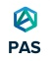
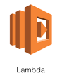
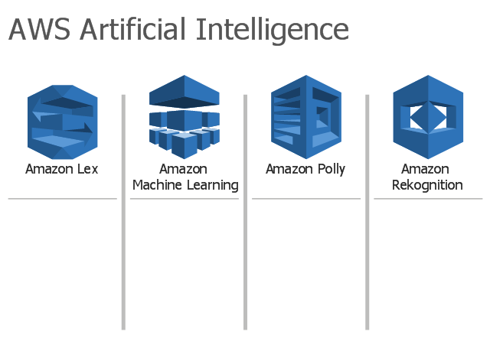

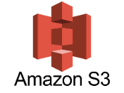


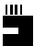
Architecture Diagram
Cloud Services
AWS SES
Weather Web Service
Dashboard
Live View
Dual language
Device Controller
Microsoft Azure Cognitive Service
Fan
relay
Data Reader
Grow light
On-premise AI
Light sensor
Sensor Reader
Temperature sensor
MQTT
Email
Soil Moisture sensor
Ultrasonic sensor
Controller
Isilon Data Lake
Dell Edge Gateway
Camera

